Slide 1
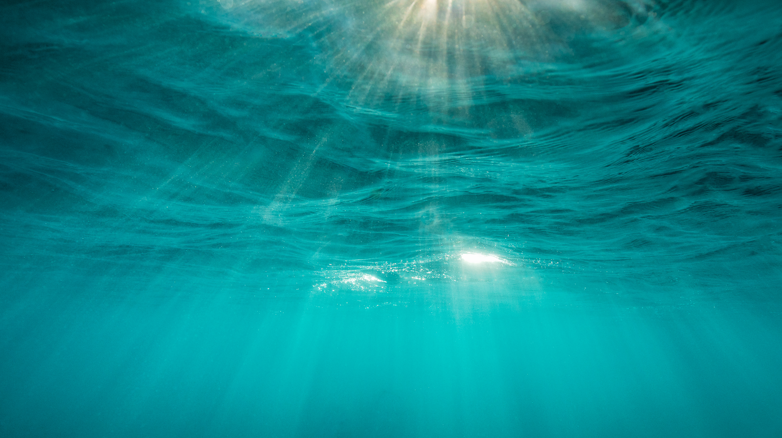
Noticing water Part 2
A mystery number investigation

Slide 2
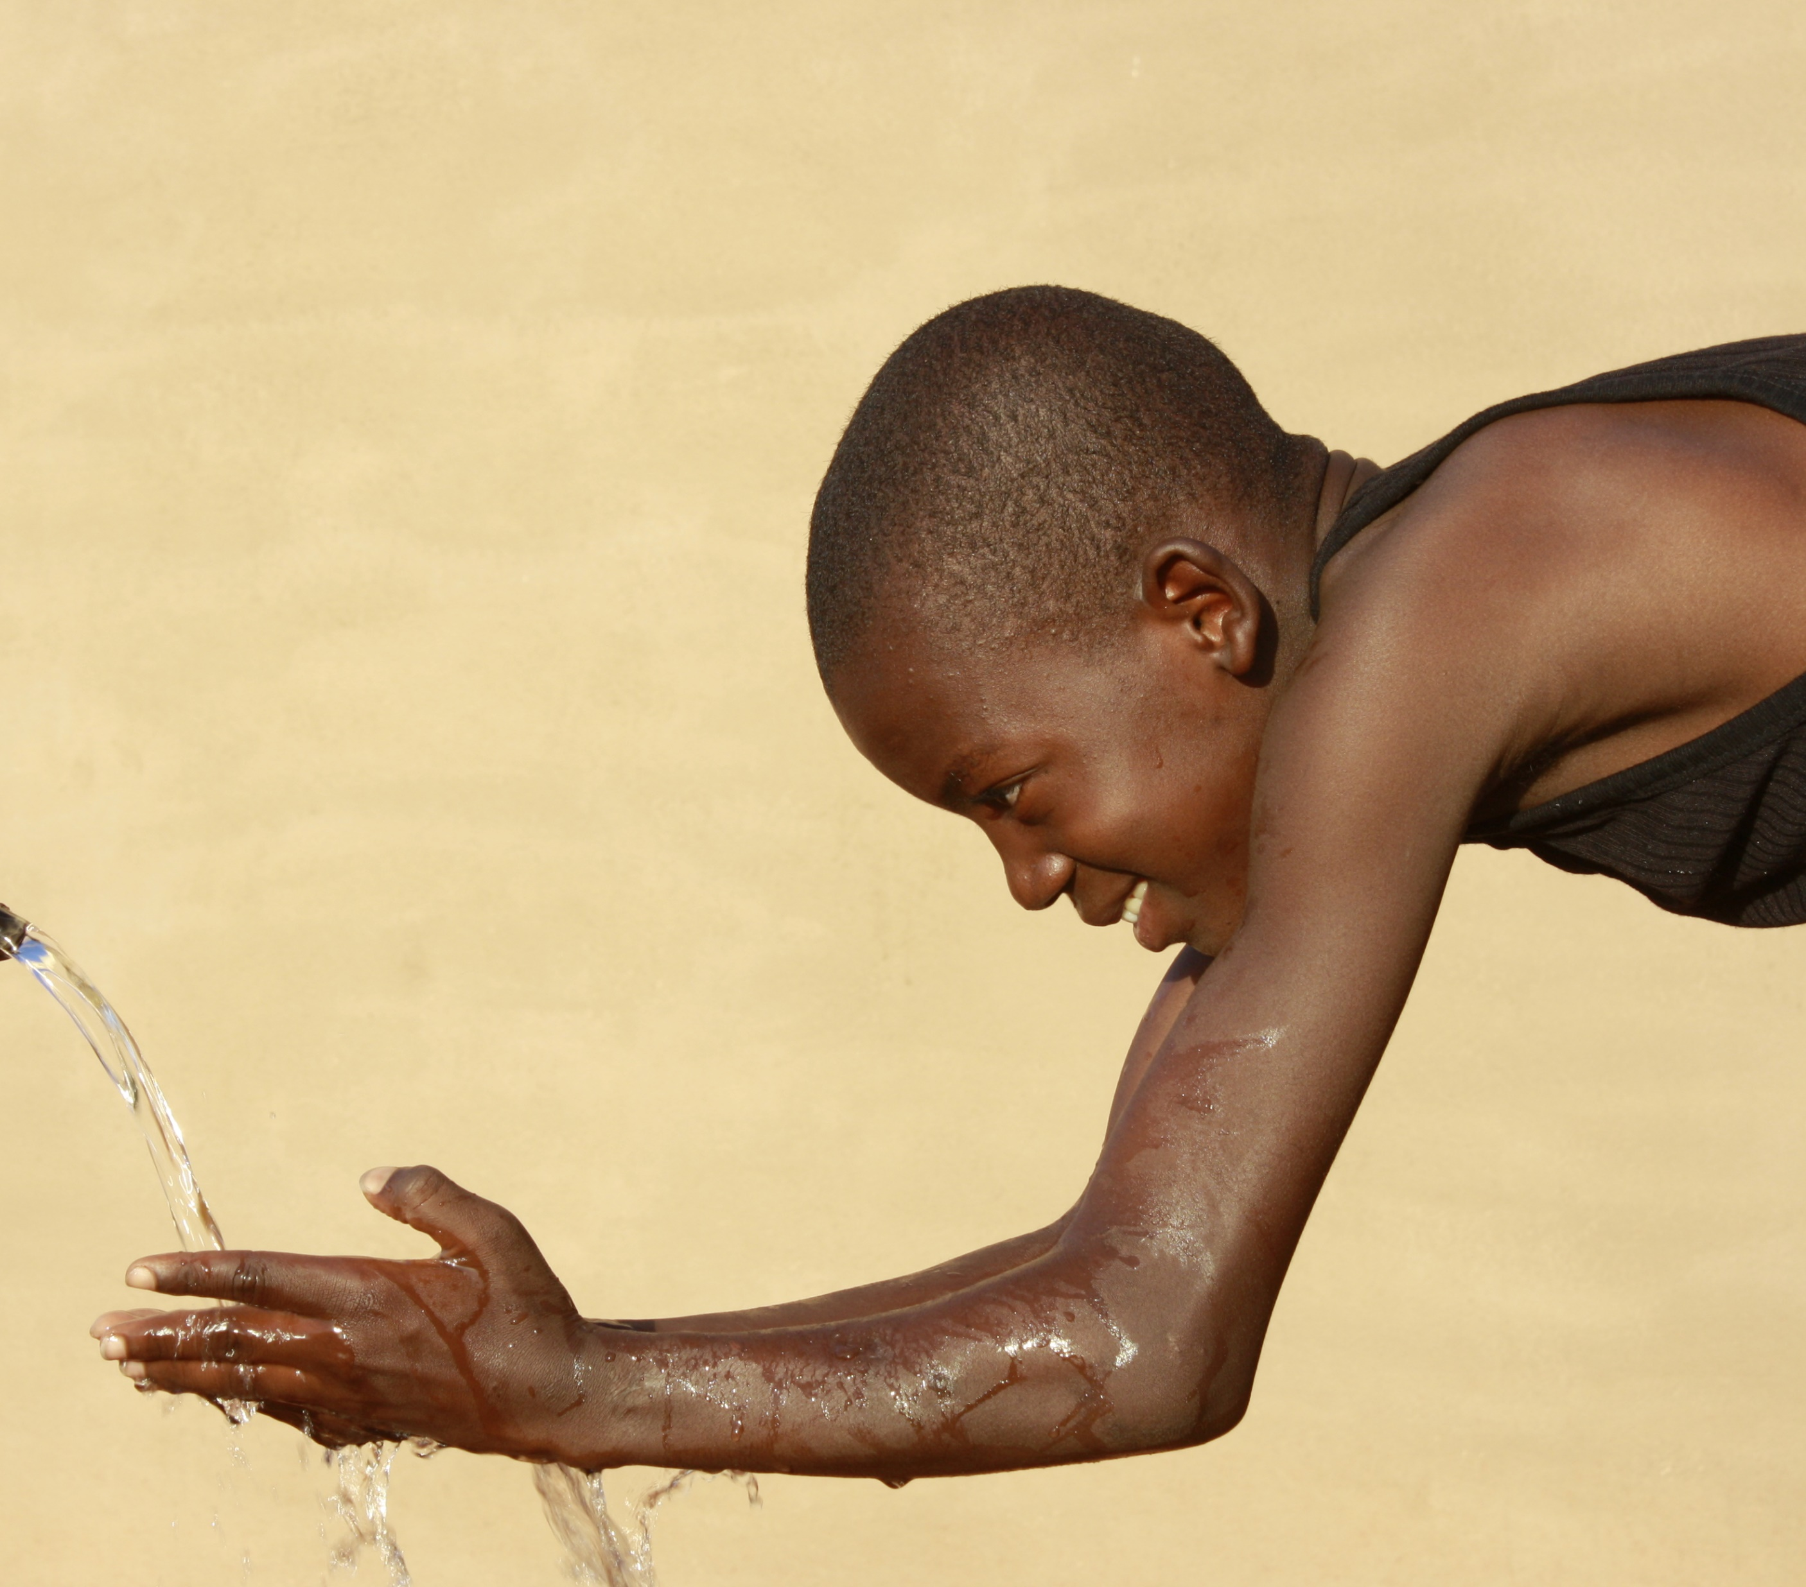
Did you know that all the life-giving water
on Earth right now was formed when the planet was formed?
That means the water you are drinking is at least __________ years old.
4 billion
Hint #1: It is a very large even number.
Hint #2: It is way more than 1 million.
Hint #3: It is a thousand millions x 4

Slide 3
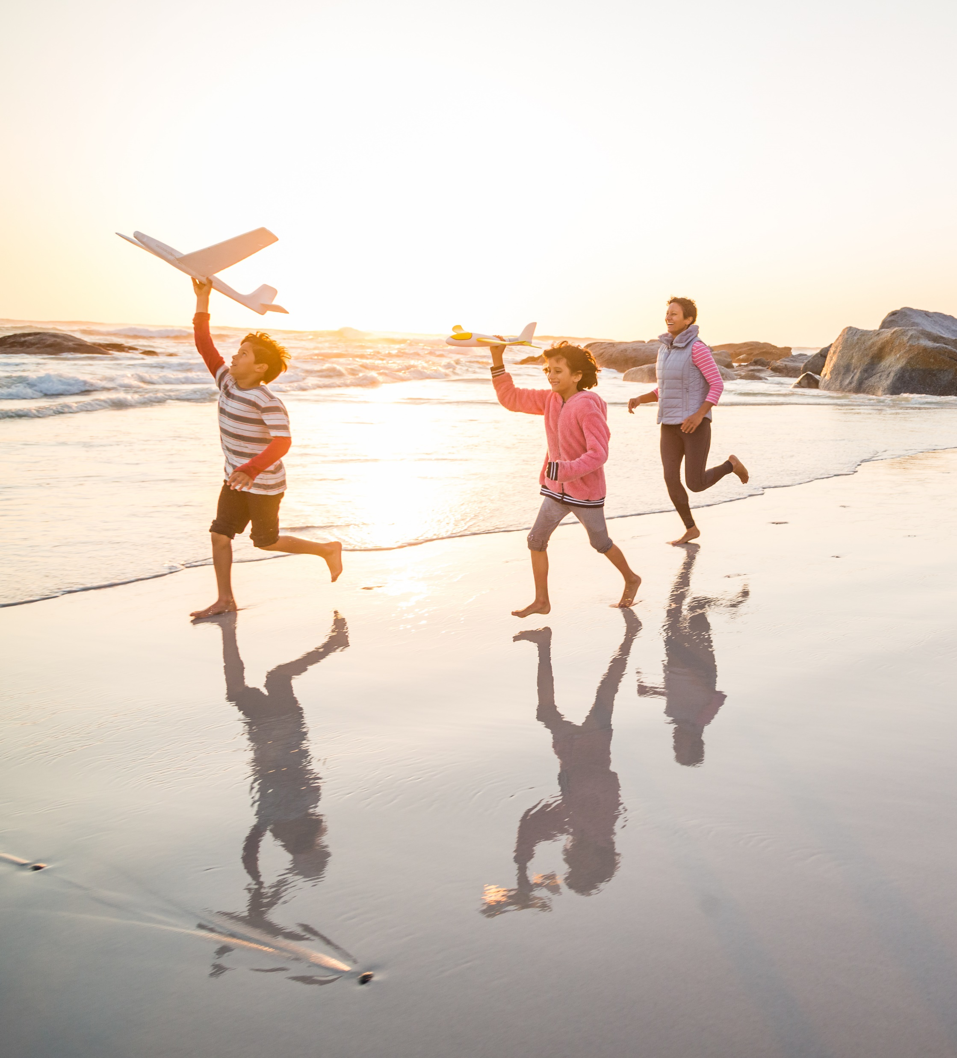
It’s a fact:
The water in our bodies is billions of years old!
Isn’t that amazing?

Slide 4
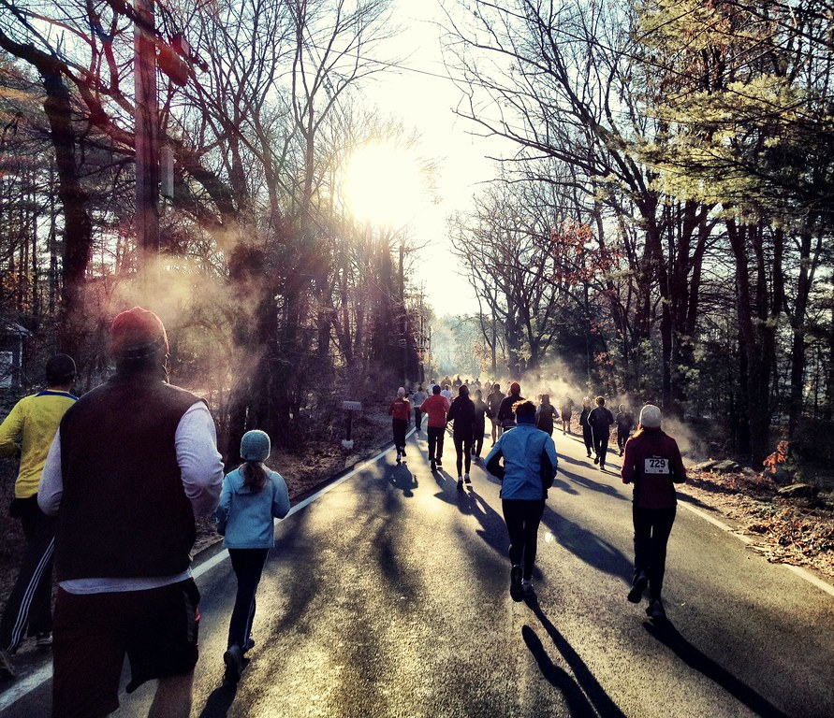
Ancient life-giving water is a restless traveler, though.
It becomes a part of your body for a short time, but then it moves on.
You breathe it out in clouds that you can see on a cold day.
You sweat it out.
Yes, you even pee it out.
That’s why you need to keep drinking water all the time.

Slide 5
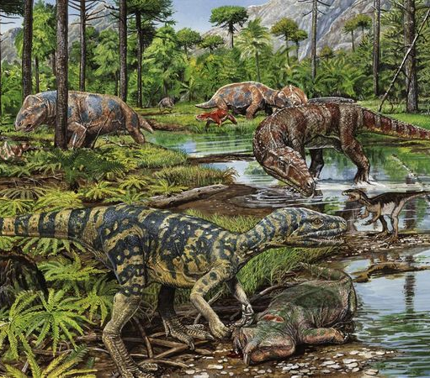
All the water on the Earth has been recycled and recycled and recycled over billions of years.
It is possible that the water you are drinking is the same water that a dinosaur drank millions of years ago!

Slide 6
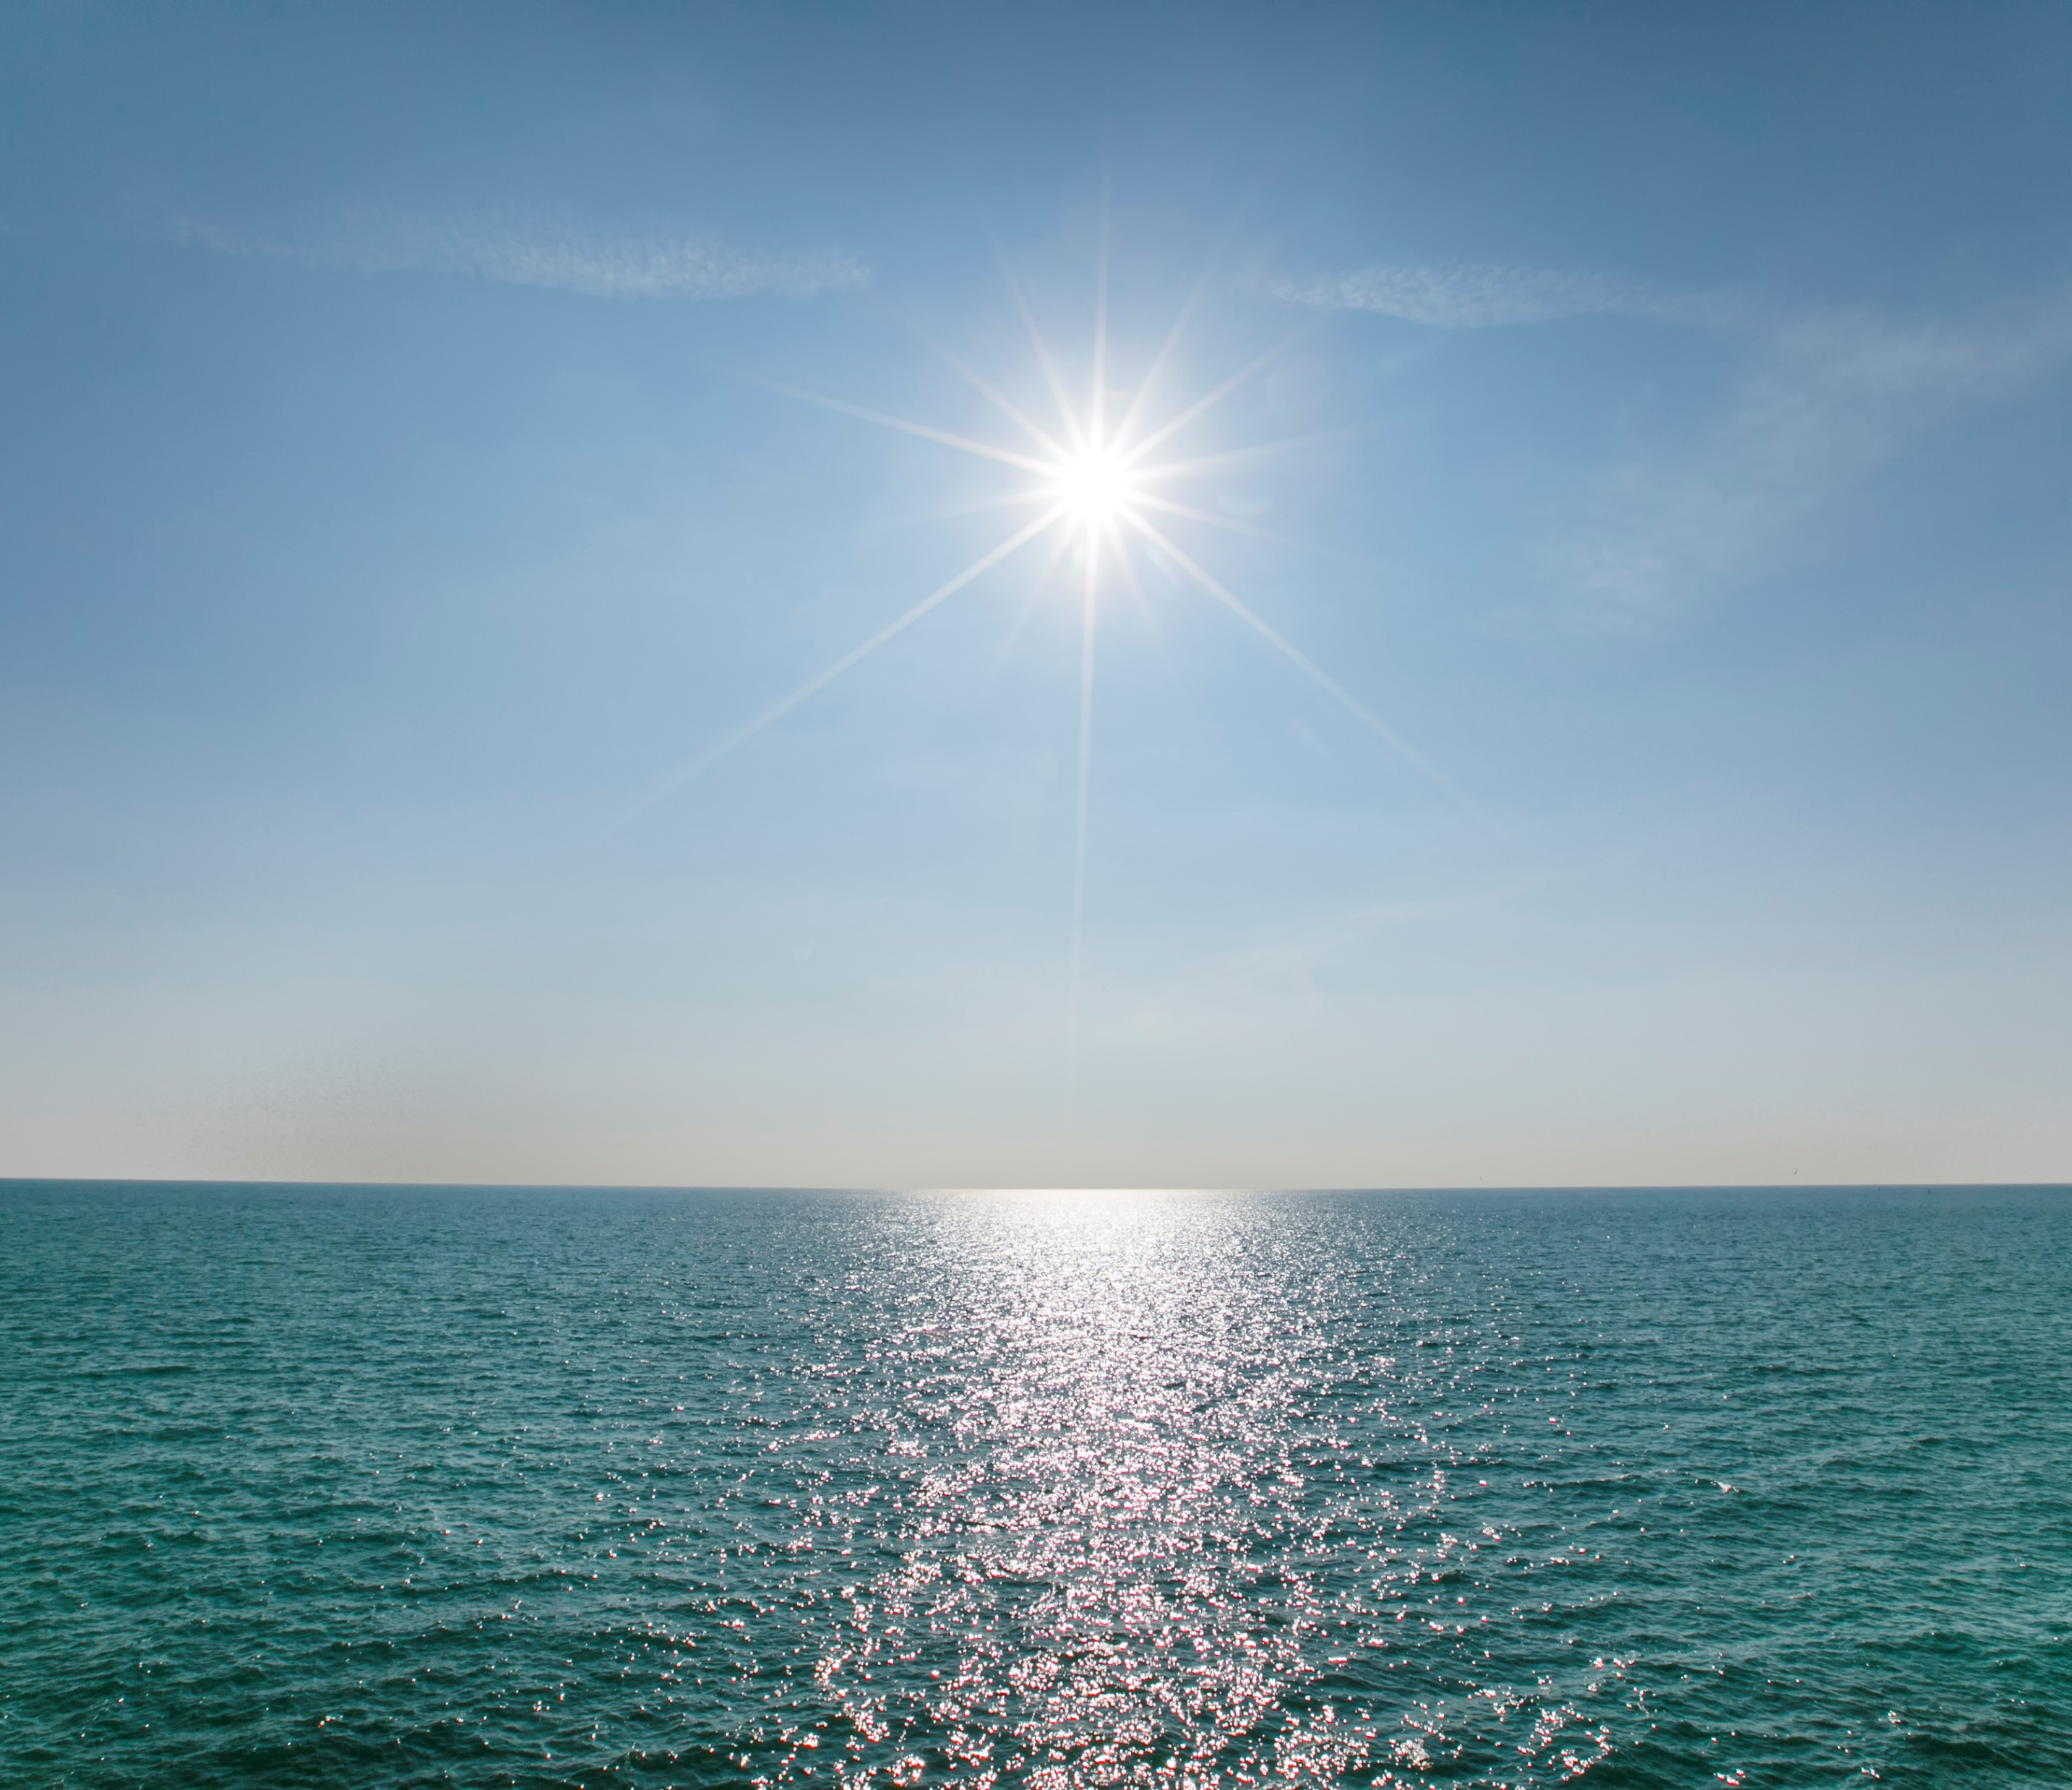
Most of that water is not safe for humans to drink.
____ percent of water on the Earth is too salty!
97
Hint #1: It is an odd number.
Hint #2: It is somewhere between 70 and 100.
Hint #3: It double 45 plus 7.

Slide 7
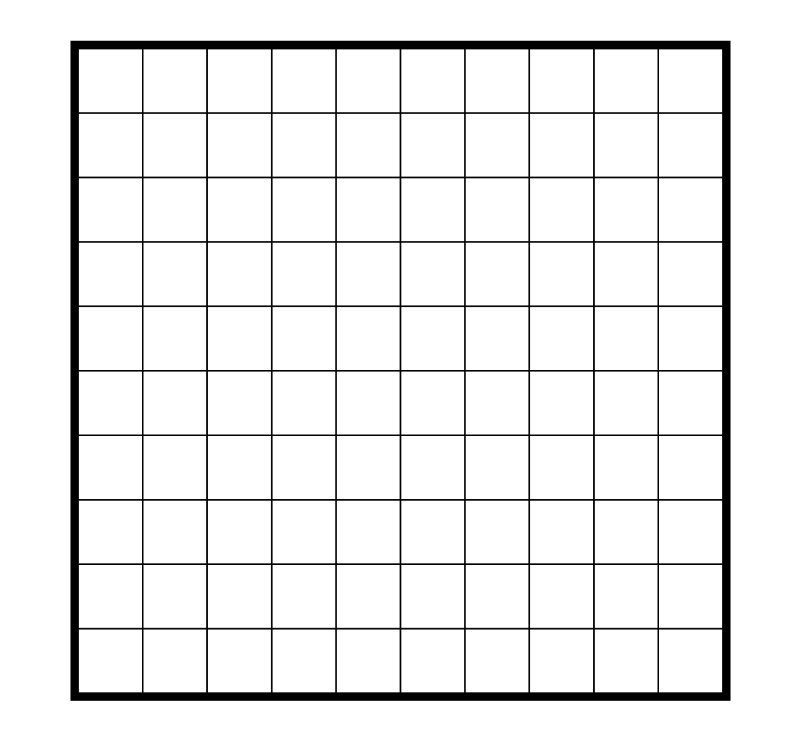
What do you think 97 percent looks like?
That’s a lot of salty water and only a small amount of fresh water.
Some of that fresh water is far underground or frozen in glaciers where humans can’t easily get it.

Slide 8
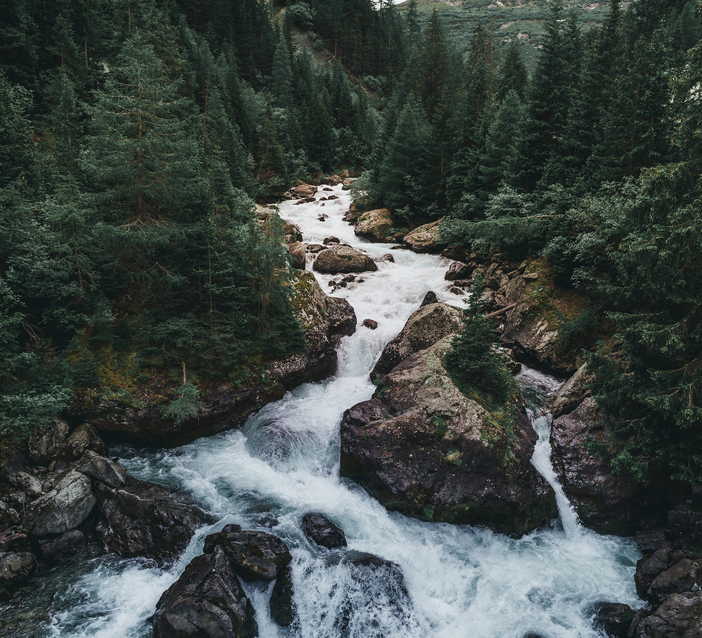
Only ___ percent of water on this Earth is the fresh type that humans can easily access.
1
Hint #1: It is an odd number.
Hint #2: It is less than 3.
Hint #3: It is less than 2.

Slide 9
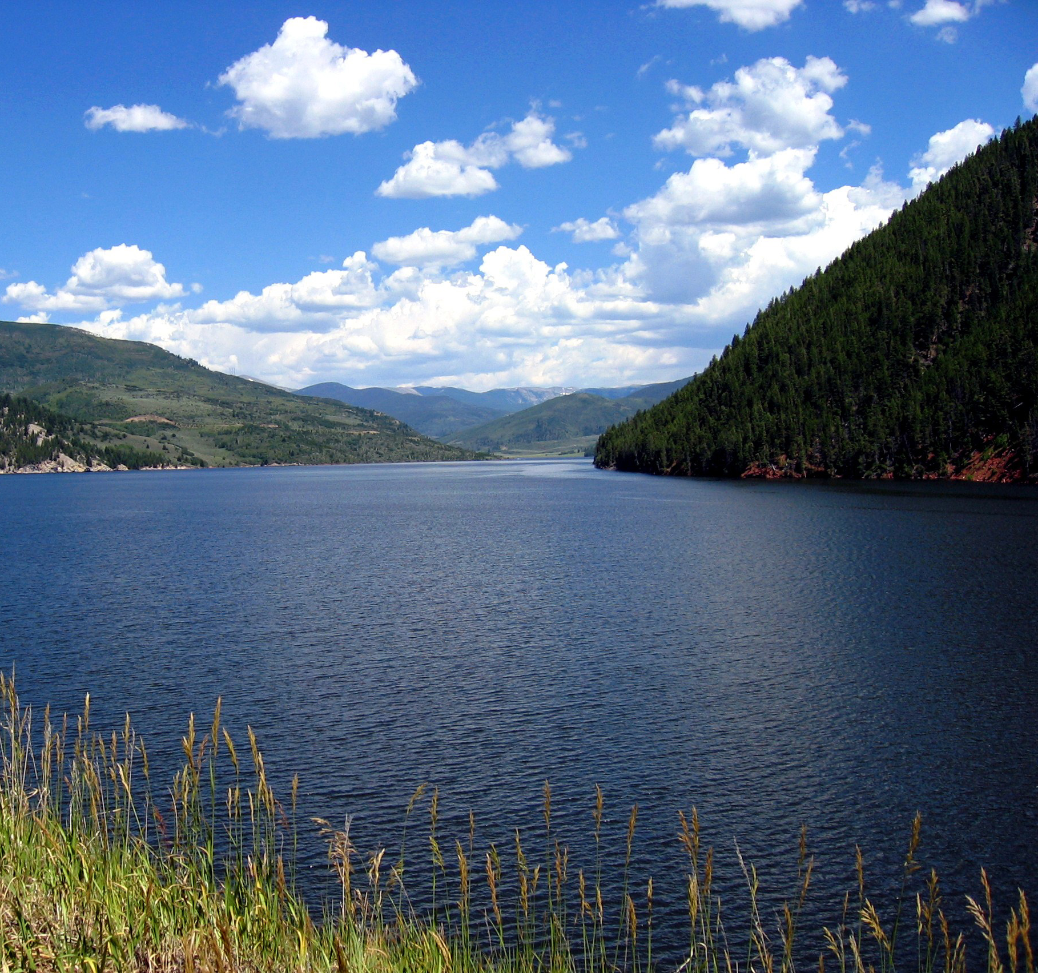
Many Canadians are lucky to have lots of drinking water. The water we drink comes mostly from lakes and rivers.
It is clean and filtered, ready-to-drink straight from the tap!

Slide 10
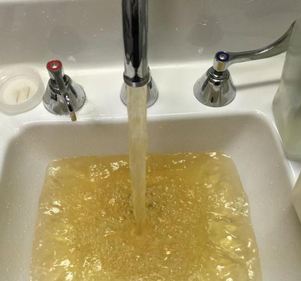
Not all Canadians are so lucky, however.
Did you know that people in ___ communities need to boil their water before it is safe to drink?
31
Hint #1: It is an odd number.
Hint #2: It is less than 50.
Hint #3: It is half of 62.

Slide 11
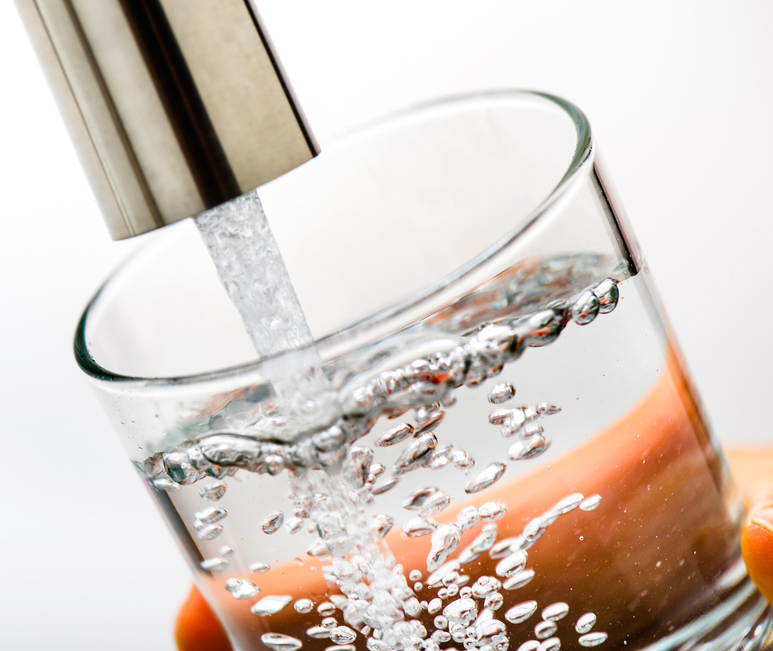
Where does the water in your community come from? Take some time to find out!
Are you one of the lucky ones with safe, clean drinking water, straight from the tap?
If you are, spend a moment feeling grateful!

Slide 12
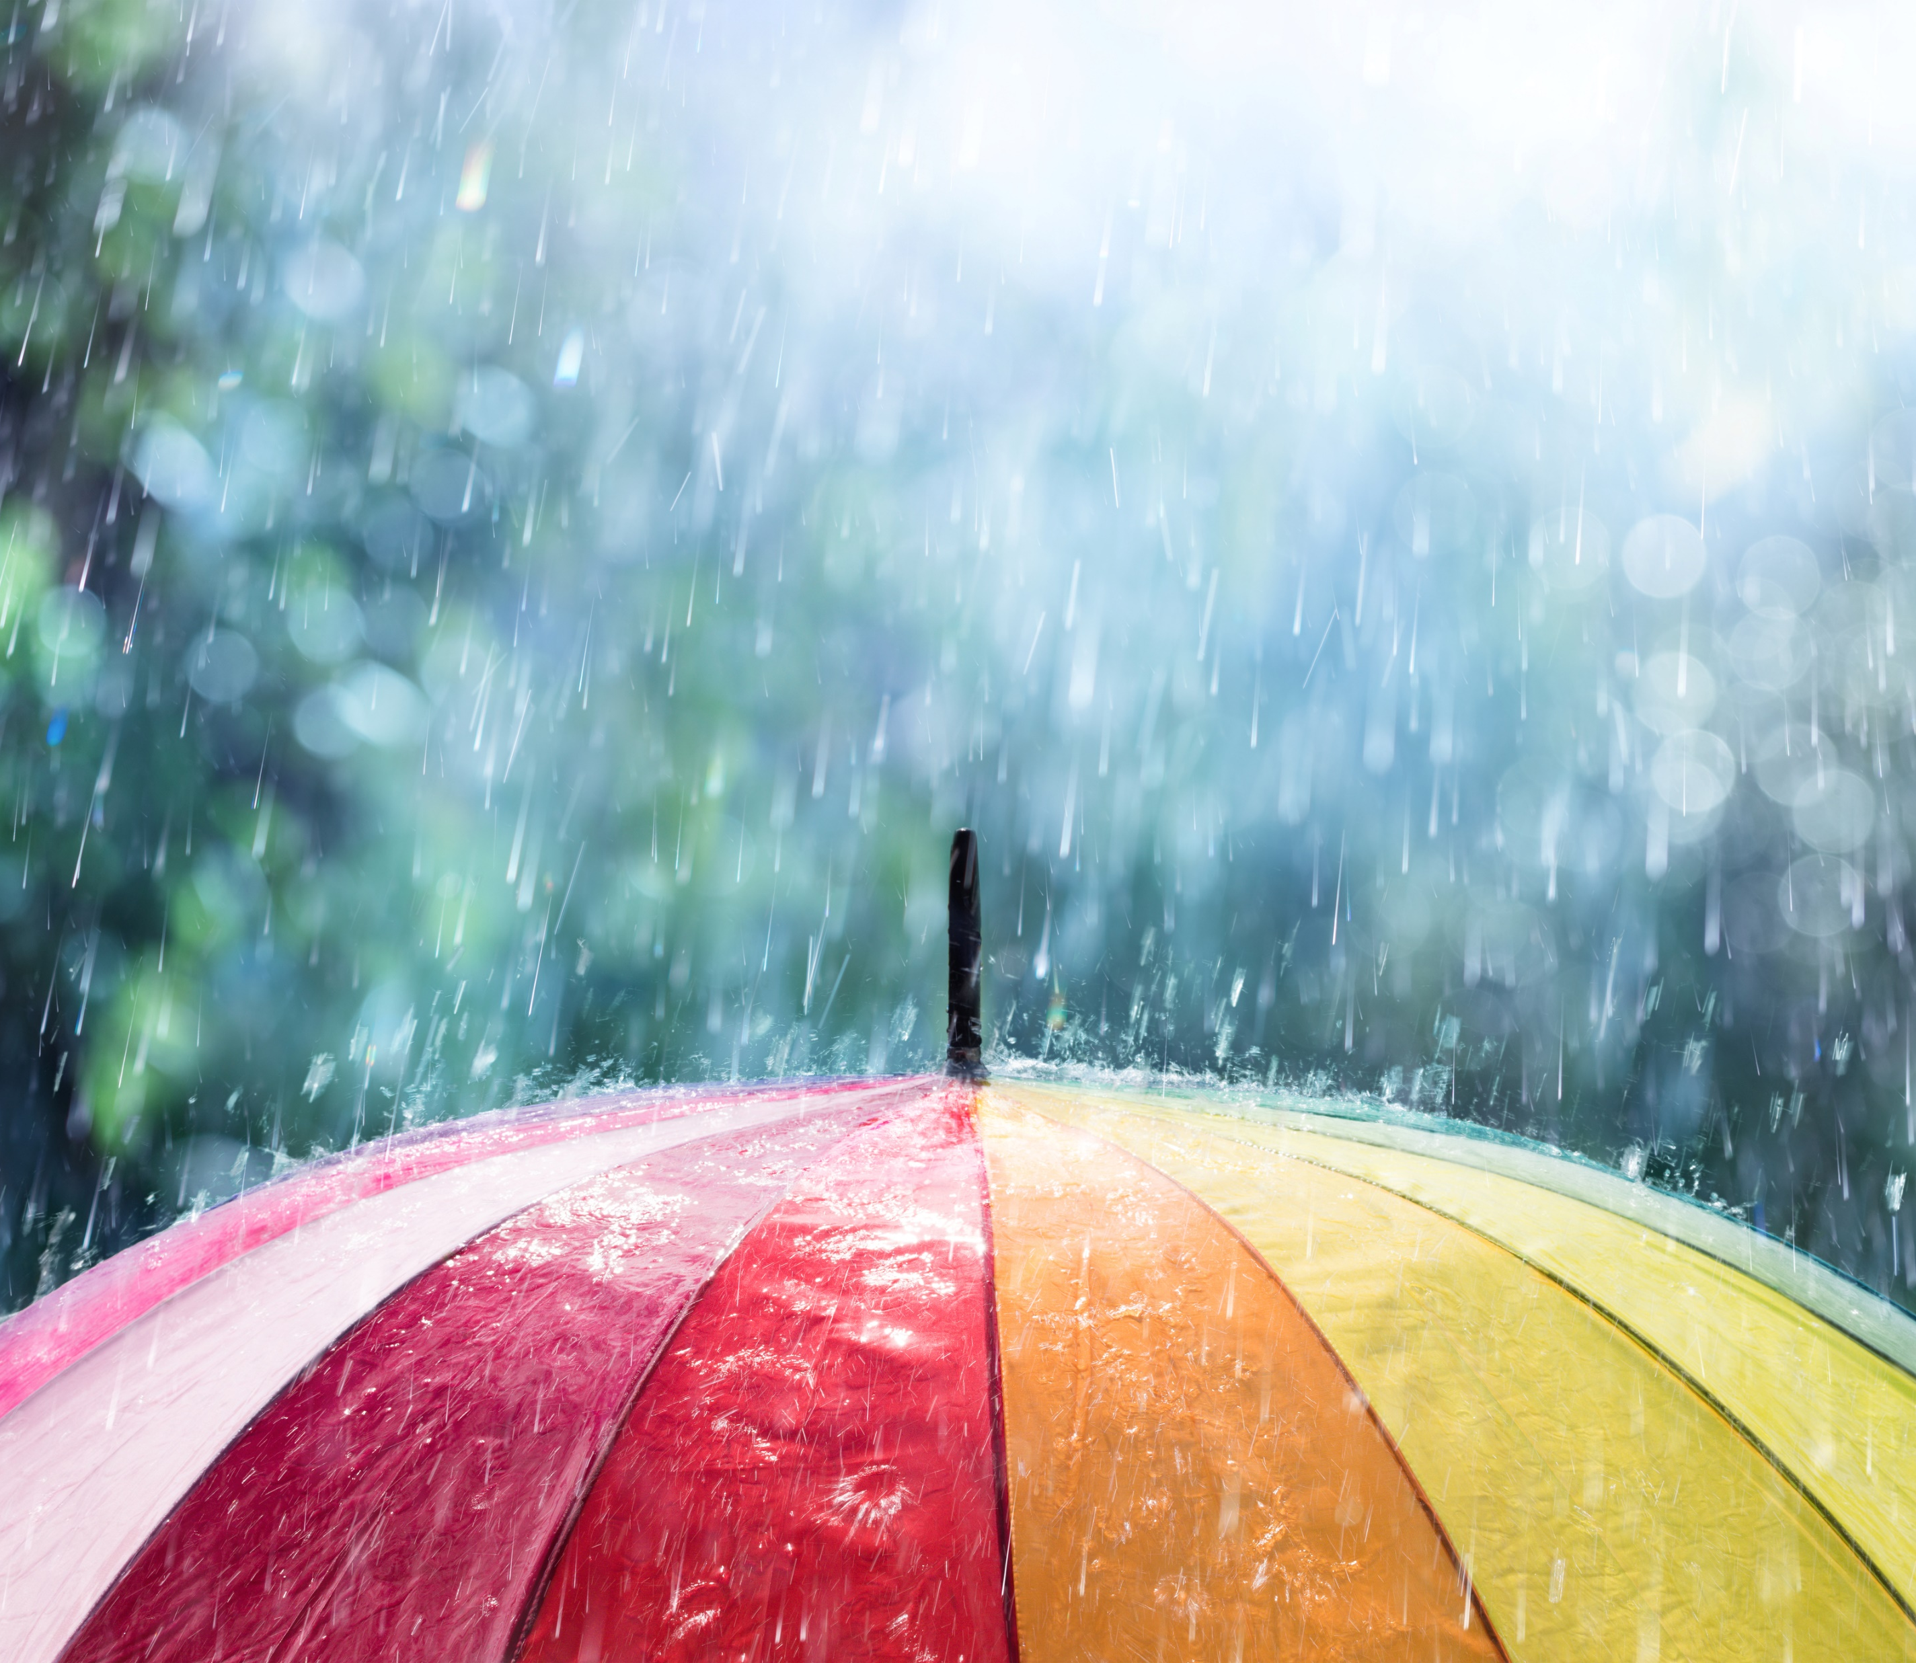
Next time it rains, try to appreciate water instead of grumbling and complaining.

Slide 13
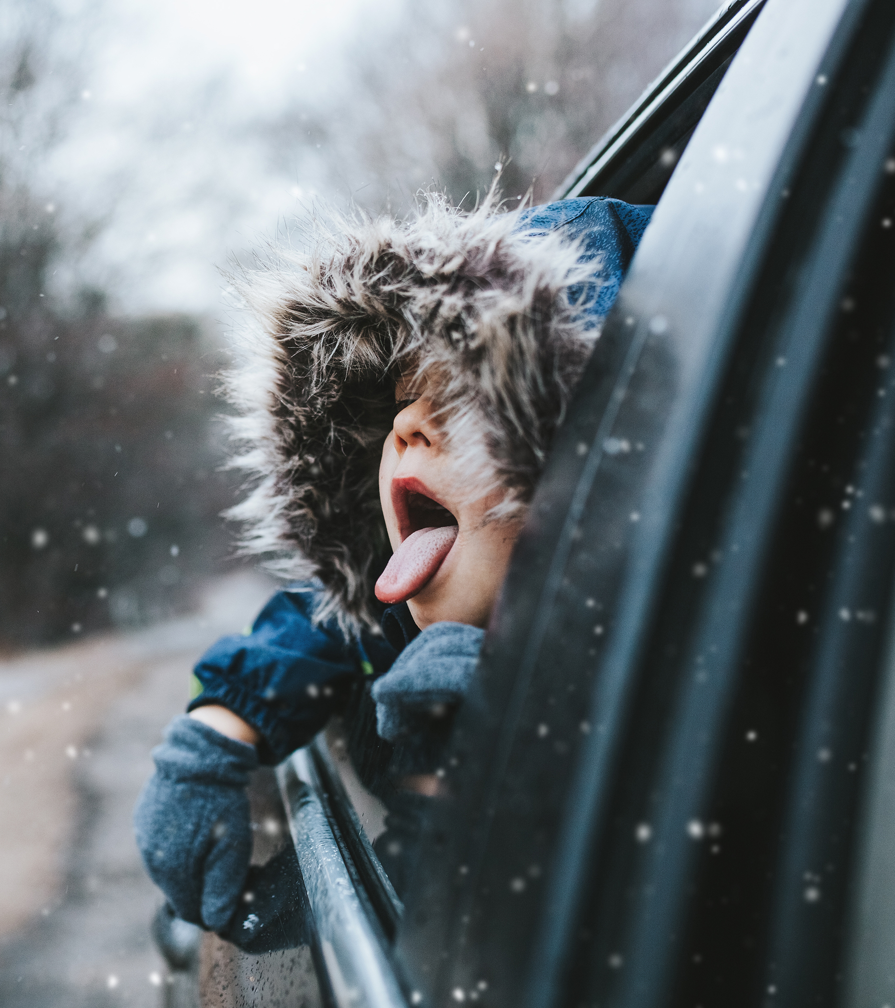
Water is ancient and precious. It is the reason we have life on the amazing planet we call home.

